Slide 1
Module 4
Support after conflict
© 2020 Copyright Elite Training Academy. ® All Rights Reserved

Slide 2
POST INCIDENT CONSIDERATIONS
Although there are many ways in which to reduce the risk conflict and assault, unfortunately there are those very rare occasions when, despite the right precautions being taken, a traumatic incident occurs.
Support after conflict
There are three key areas you should consider following an incident:
providing support
1
learning from what happened
2
3
sharing good practice
© 2020 Copyright Elite Training Academy. ® All Rights Reserved

Slide 3
POST INCIDENT CONSIDERATIONS
Responses to conflict and trauma
Lost sleep/sickness
Behaviour changes
Withdrawal
Flashbacks
Intolerance
Hypersensitivity
Loss of confidence.
Support after conflict
Responses to trauma
© 2020 Copyright Elite Training Academy. ® All Rights Reserved

Slide 4
POST INCIDENT CONSIDERATIONS
Providing support to those who have managed conflict
Give immediate and continued support
Demonstrate your interest – listen actively, show you care
Contact the person if they are off sick
Share work out to relieve their stress
Keep the manager and other colleagues informed
Look for signs in colleagues, such as changes in behaviour
Support both the individual and their family.
Support after conflict
Responses to trauma
Talk to me
© 2020 Copyright Elite Training Academy. ® All Rights Reserved

Slide 5
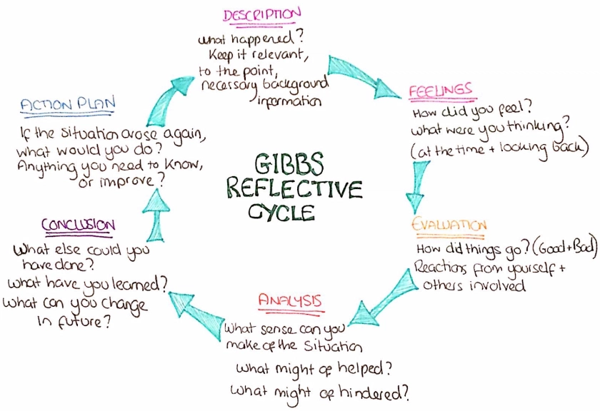
POST INCIDENT CONSIDERATIONS
Reflecting and learning
what happened
what can be done differently
good practices
how others can be informed
how learning can be shared.
Support after conflict
Responses to trauma
© 2020 Copyright Elite Training Academy. ® All Rights Reserved

Slide 6
POST INCIDENT CONSIDERATIONS
Sharing good practice
A culture should be developed and encouraged in which disseminating helpful and relevant information, in order to generate ideas for future safety and prevention of conflict, is promoted.
Incident
What can I learn for next time?
What happened?
Support after conflict
Responses to trauma
Why did it happen?
Reflect on how you handled the incident
Look for things you did well so you can offer advice to your colleagues
Recognise the things that did not go so well so you can think about how to improve next time.
© 2020 Copyright Elite Training Academy. ® All Rights Reserved

Slide 7
POST INCIDENT CONSIDERATIONS
Debriefing
Helps us to improve how we deal with similar problems in the future
Support after conflict
Responses to trauma
Reduces the chances of them happening in the first place
Or can even stop them from happening at all.
© 2020 Copyright Elite Training Academy. ® All Rights Reserved

Slide 8
Ongoing support
It is important that businesses and organisations are able to help staff after an incident of workplace violence, particularly in relation to:
Support after conflict
Responses to trauma
Providing immediate and ongoing support
Helping all members of staff to learn from the incident
Updating policies and procedures to improve safety
© 2020 Copyright Elite Training Academy. ® All Rights Reserved

Slide 9
Ongoing support
Potential effects of exposure to workplace violence
Short-term and long-term symptoms following exposure to workplace violence could include:
Sickness
Insomnia
Behavioural changes
Becoming withdrawn
Anxiety
Intolerance
Hypersensitivity
Support after conflict
Responses to trauma
© 2020 Copyright Elite Training Academy. ® All Rights Reserved

Slide 10
Ongoing support
In more serious cases, professional help can be sought via:
The Victim Support Scheme
A confidential counselling service
Through the person’s own NHS or private doctor.
Support after conflict
Responses to trauma
© 2020 Copyright Elite Training Academy. ® All Rights Reserved

Slide 11
Thankyou for your participation
© 2020 Copyright Elite Training Academy. ® All Rights Reserved

Slide 12
1
Knowledge Quiz
A
B
C
D
© 2020 Copyright Elite Training Academy. ® All Rights Reserved

